Slide 1
VAC on JAVA Programming
Dr. Thanapal P
Associate Professor Senior
Vellore Institute of Technology, Vellore
thanapal.p@vit.ac.in
9994311188

Slide 2
INTRODUCTION TO JAVA
WHAT ?????????????????????

Slide 3
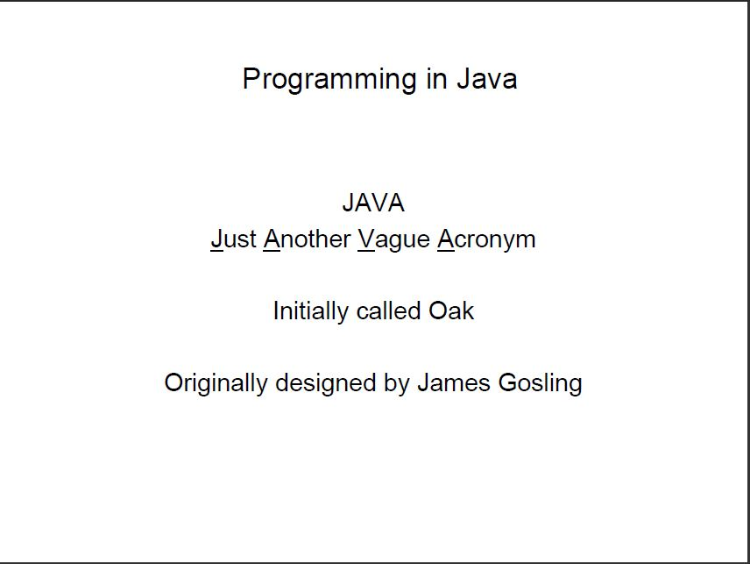

Slide 4
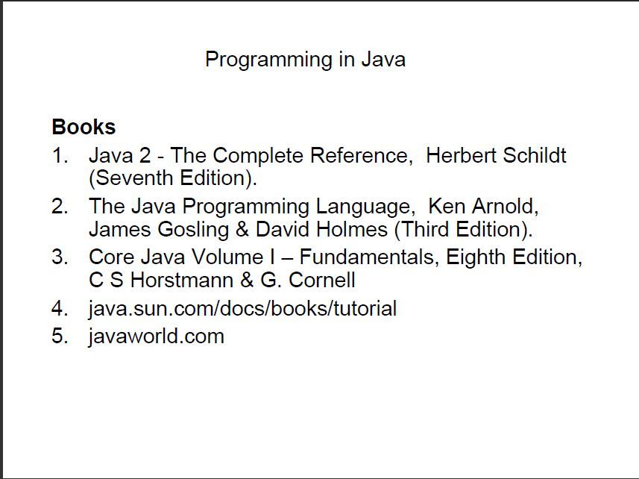

Slide 5
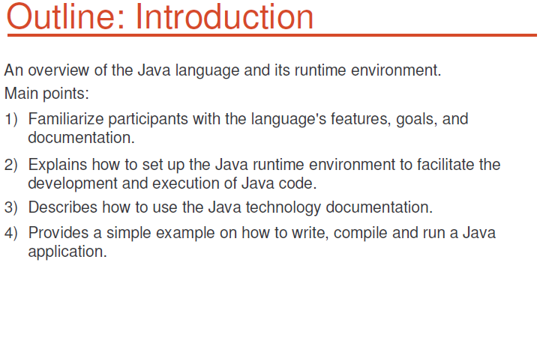
INTRODUCTION

Slide 6
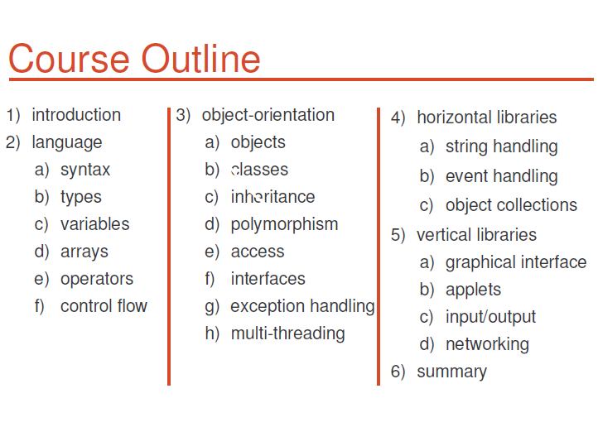

Slide 7
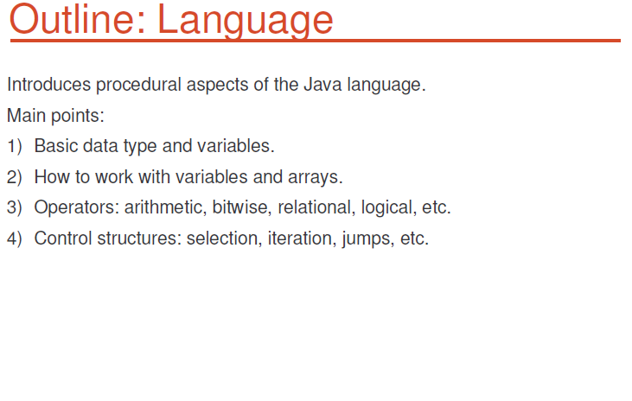
INTRODUCTION(Cont.)

Slide 8
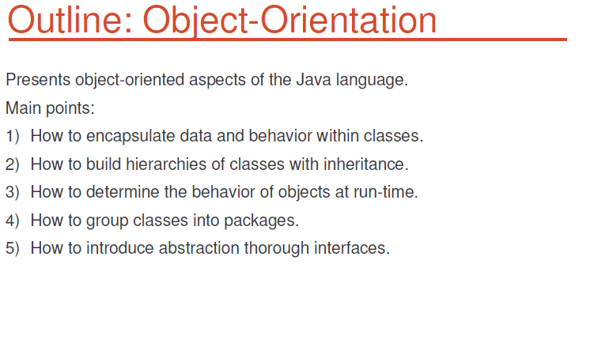
INTRODUCTION(Cont.)

Slide 9
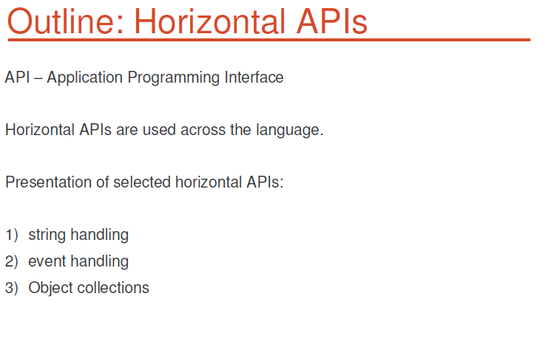

Slide 10
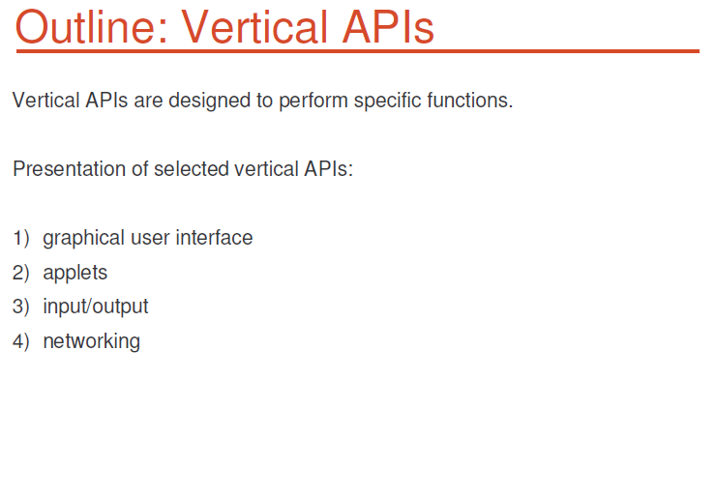

Slide 11
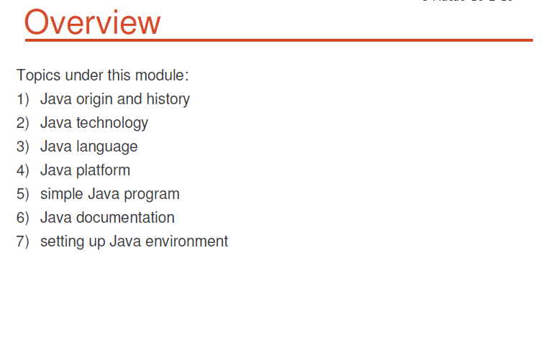

Slide 12
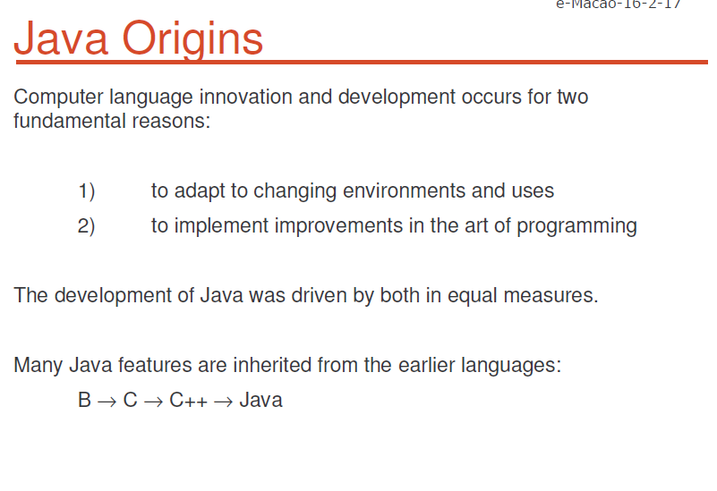

Slide 13
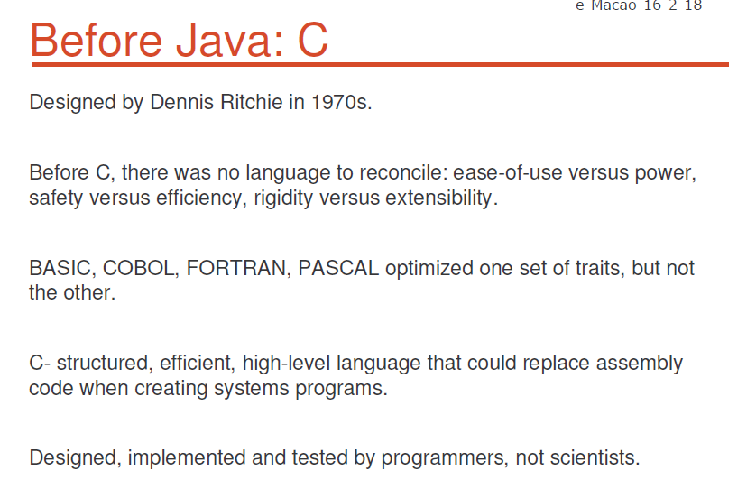

Slide 14
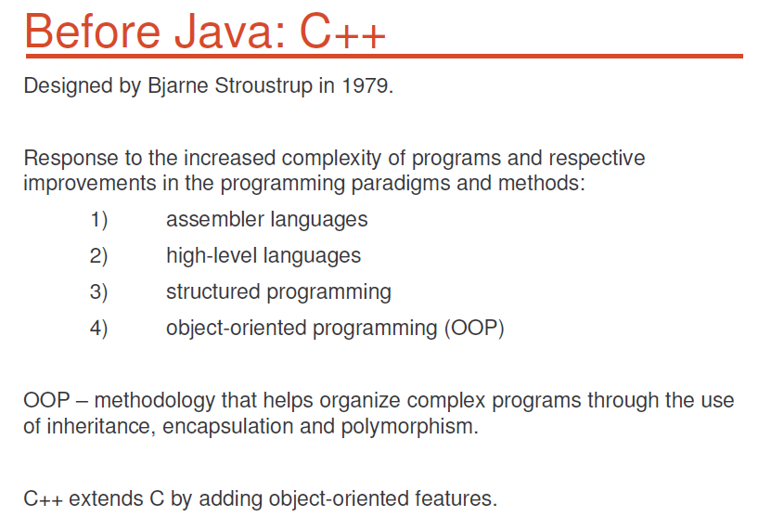

Slide 15
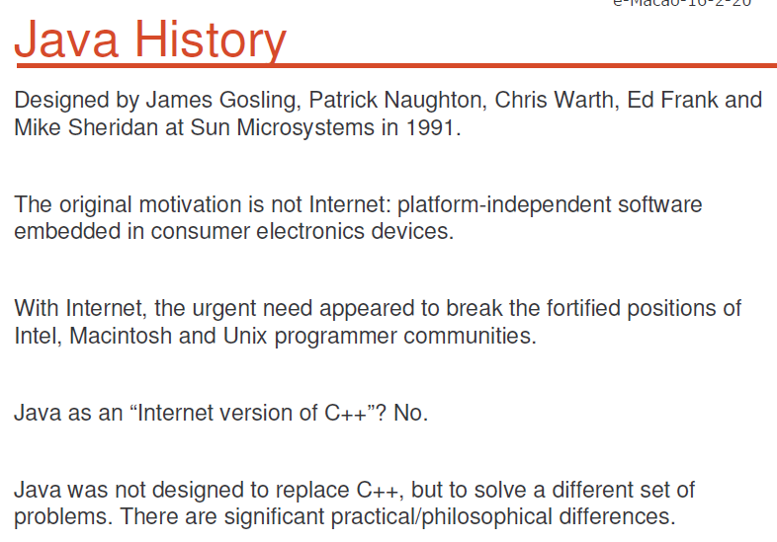

Slide 16
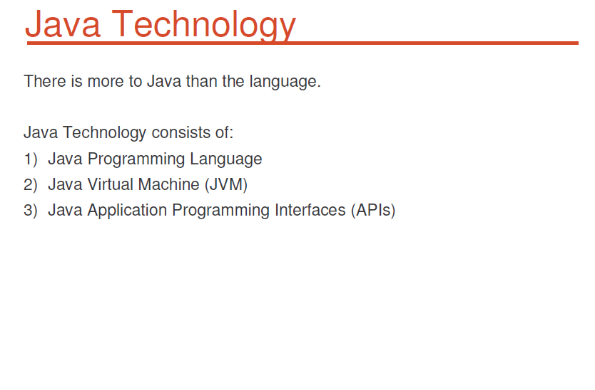

Slide 17
THANK YOU!!!

